Slide 1
Hierarchical Clustering

Slide 2
Hierachical clustering
Agglomerative and divisive clustering on the data set {a, b, c, d ,e }
Step 0
Step 1
Step 2
Step 3
Step 4
Agglomerative
a
a b
b
a b c d e
c
c d e
d
d e
e
Divisive
Step 4
Step 3
Step 2
Step 1
Step 0

Slide 3
Agglomerative Clustering
The agglomerative clustering is the most common type of hierarchical clustering used to group objects in clusters based on their similarity.
The algorithm starts by treating each object as a singleton cluster.
Next, pairs of clusters are successively merged until all clusters have been merged into one big cluster containing all objects.
The result is a tree-based representation of the objects, named dendrogram

Slide 4
Agglomerative clustering
Convert object attributes to distance matrix
Set each object as a cluster (thus if we have N objects, we will have N clusters at the beginning)
Repeat until number of cluster is one (or known # of clusters)
Merge two closest clusters
Update distance matrix
d3
d5
d1
d3,d4,d5
d4
d2
d1,d2
d4,d5
d3

Slide 5
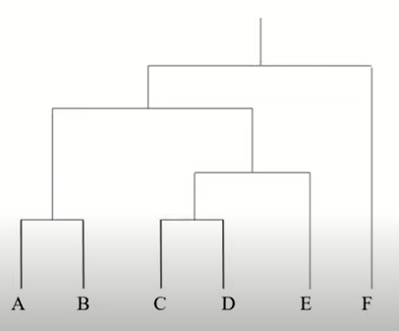
Dendogram

Slide 6
Starting Situation
Start with clusters of individual points and a distance/proximity matrix
p1
p2
p3
p4
p5
. . .
p1
p2
p3
p4
p5
.
.
.
Distance Matrix

Slide 7
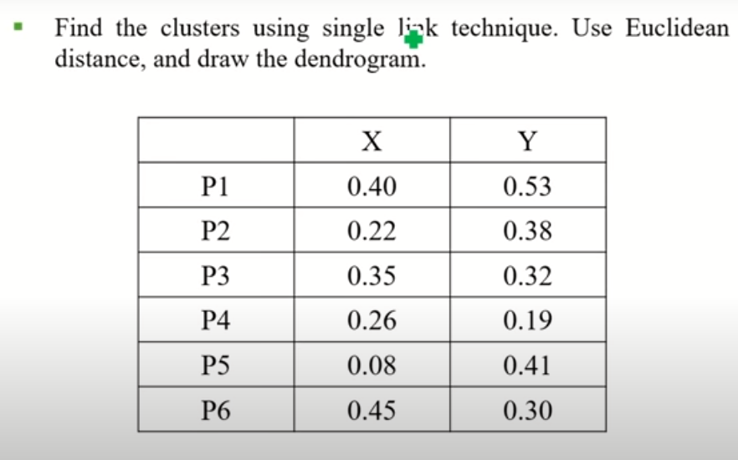
EXAMPLE – SINGLE LINK

Slide 8
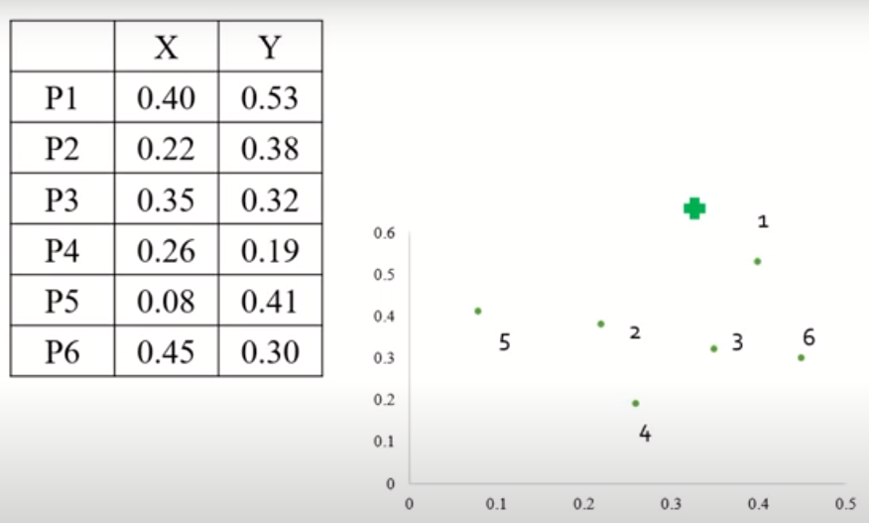
EXAMPLE – SINGLE LINK

Slide 9
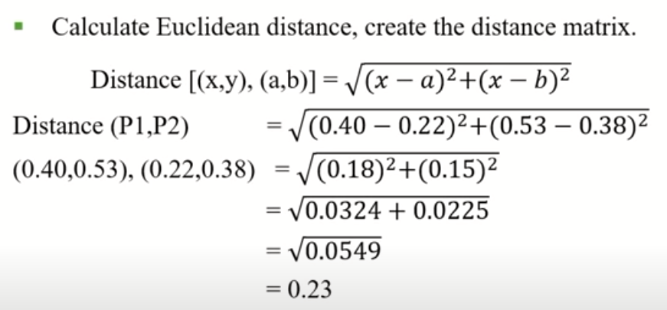
EXAMPLE – SINGLE LINK

Slide 10
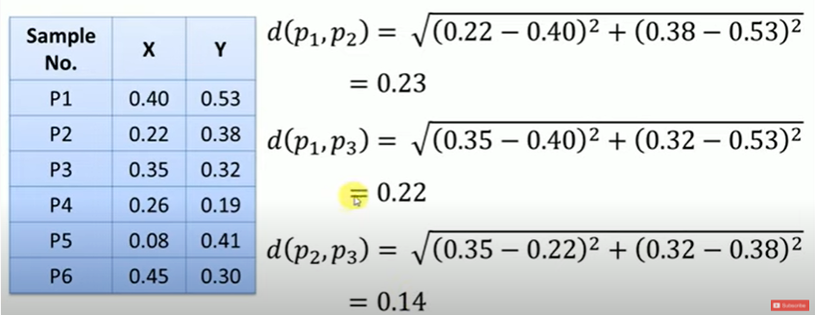
EXAMPLE – SINGLE LINK

Slide 11
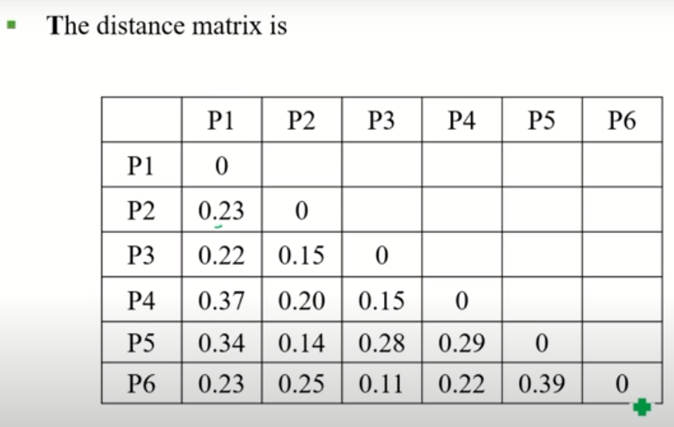
EXAMPLE – SINGLE LINK

Slide 12
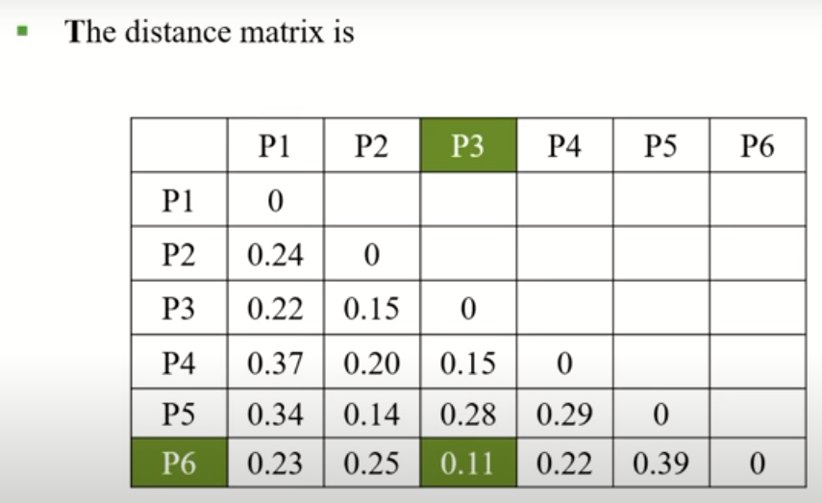
EXAMPLE – SINGLE LINK

Slide 13
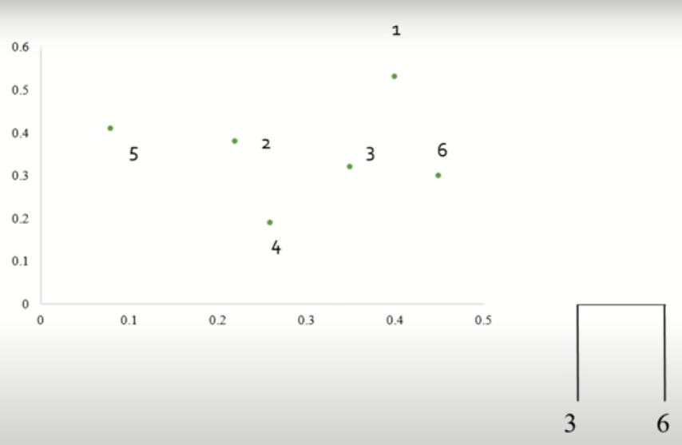
EXAMPLE – SINGLE LINK

Slide 14
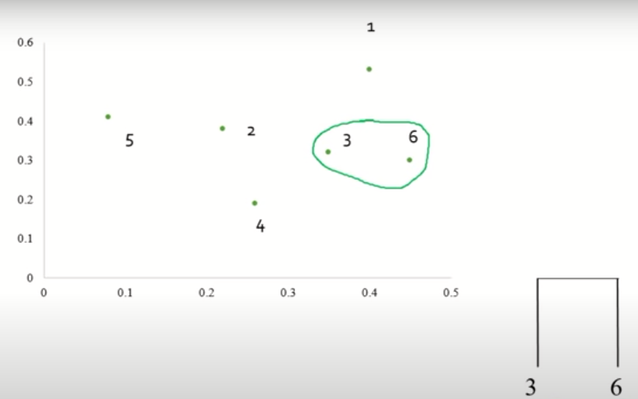
EXAMPLE – SINGLE LINK

Slide 15
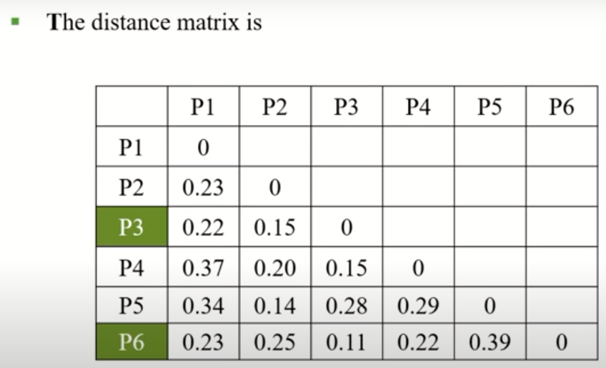
EXAMPLE – SINGLE LINK

Slide 16
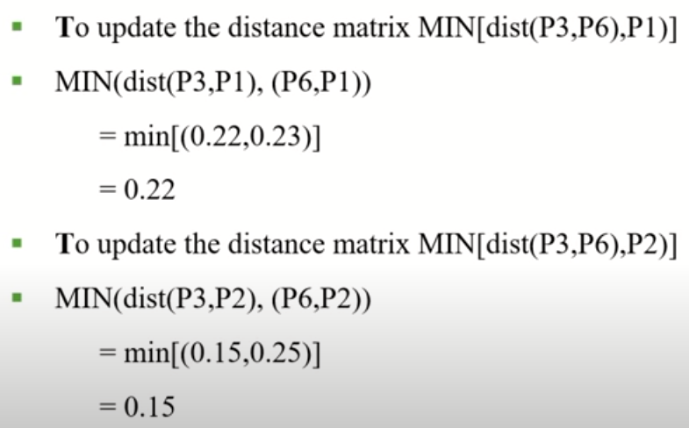
EXAMPLE – SINGLE LINK

Slide 17
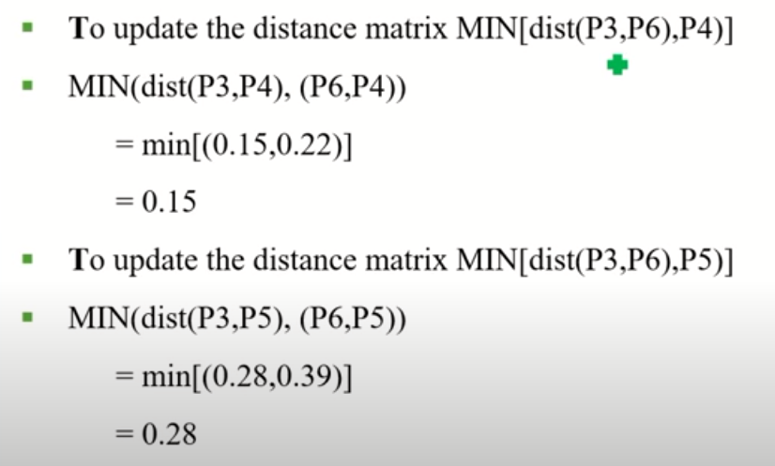
EXAMPLE – SINGLE LINK

Slide 18
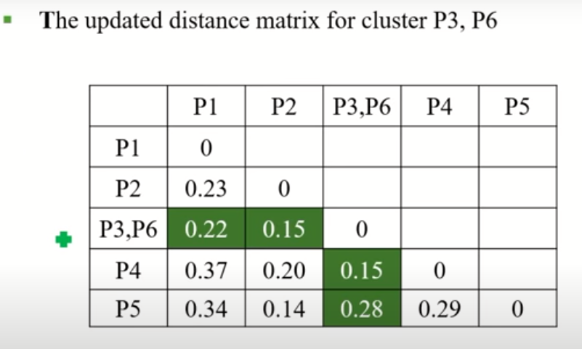
EXAMPLE – SINGLE LINK

Slide 19
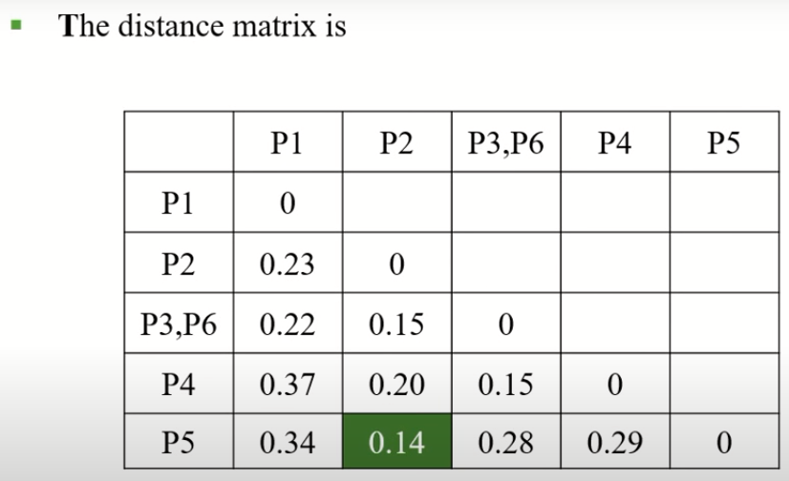
EXAMPLE – SINGLE LINK

Slide 20
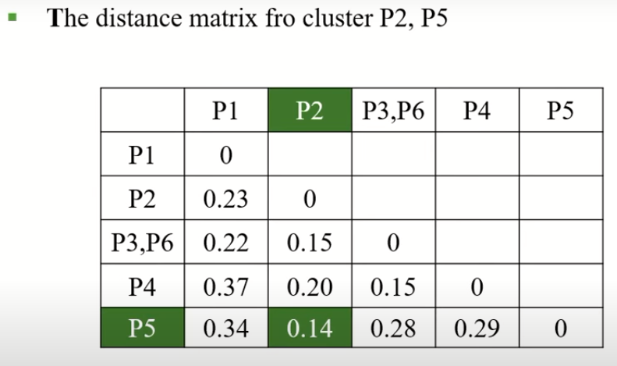
EXAMPLE – SINGLE LINK

Slide 21
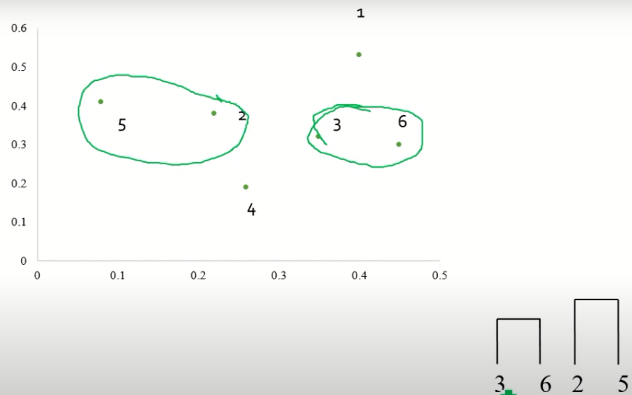
EXAMPLE – SINGLE LINK

Slide 22
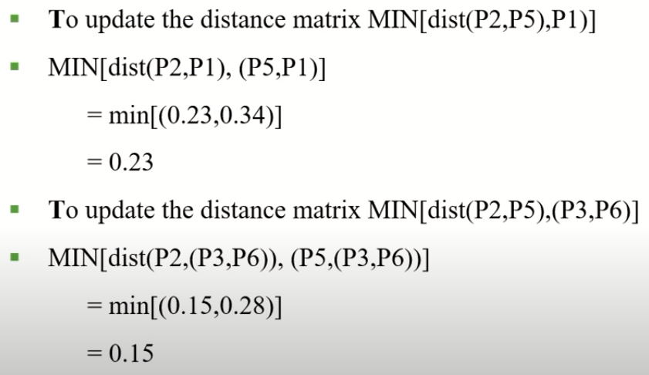
EXAMPLE – SINGLE LINK

Slide 23
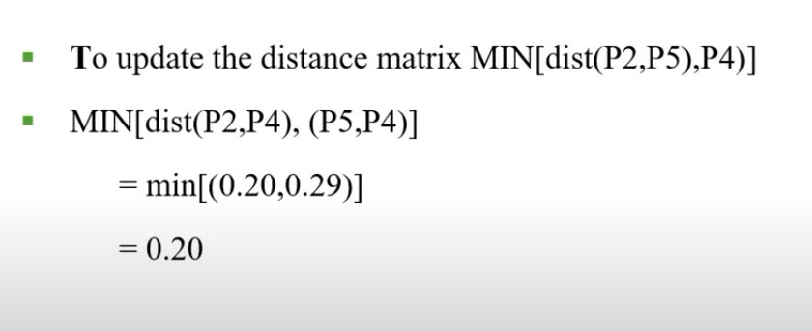
EXAMPLE – SINGLE LINK

Slide 24
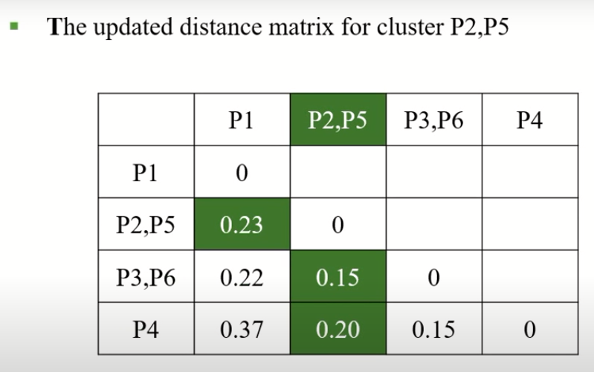
EXAMPLE – SINGLE LINK

Slide 25
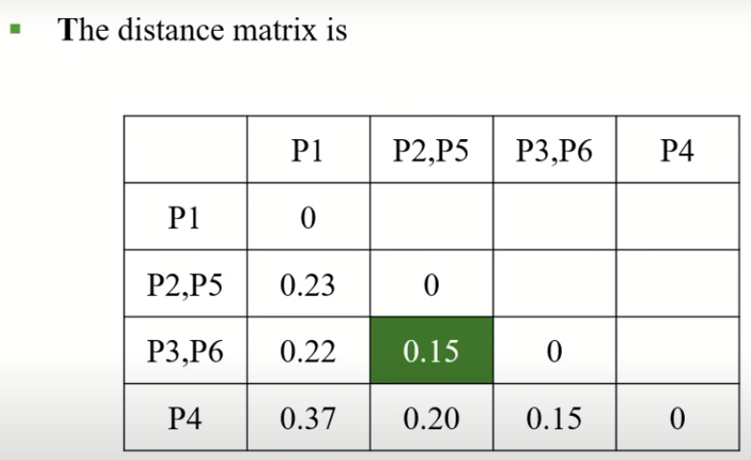
EXAMPLE – SINGLE LINK

Slide 26
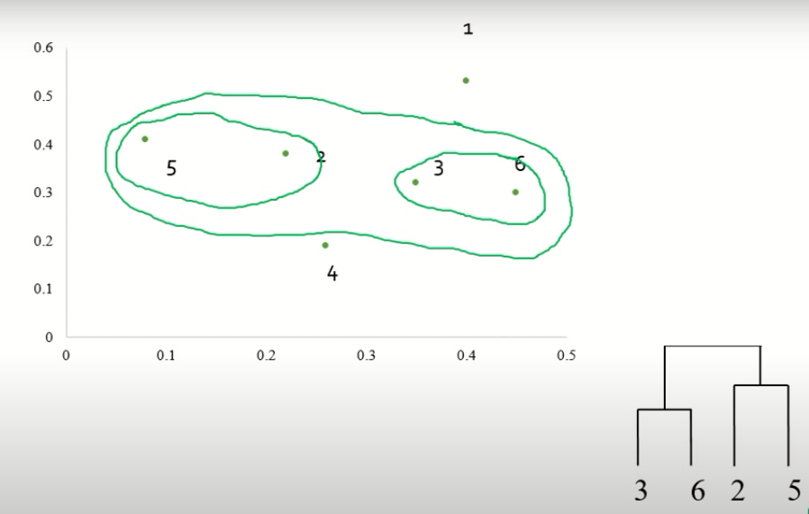
EXAMPLE – SINGLE LINK

Slide 27
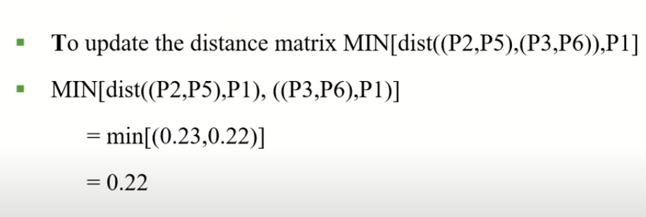
EXAMPLE – SINGLE LINK

Slide 28
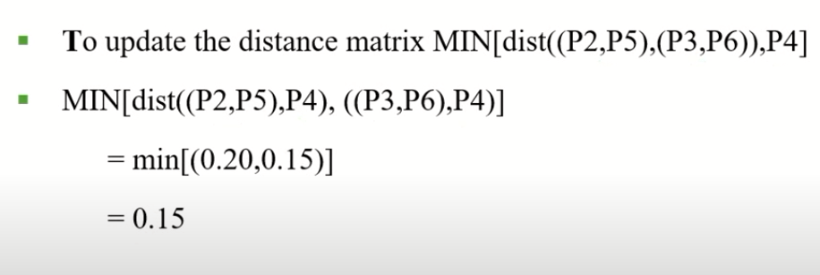
EXAMPLE – SINGLE LINK

Slide 29
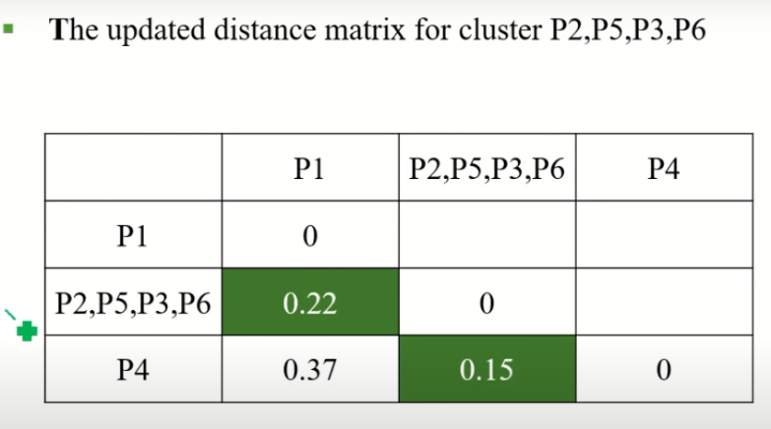
EXAMPLE – SINGLE LINK

Slide 30
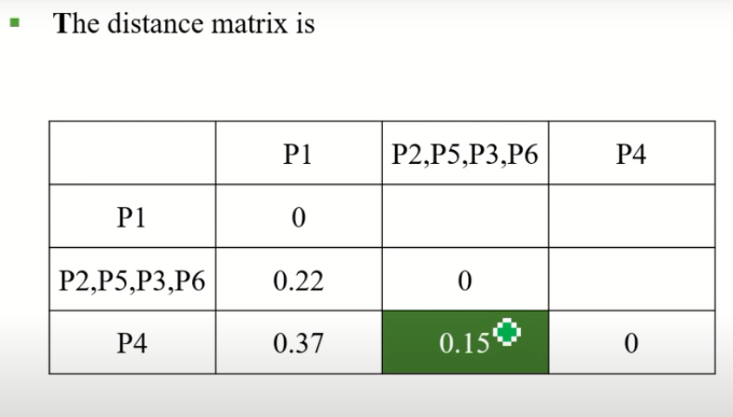
EXAMPLE – SINGLE LINK

Slide 31
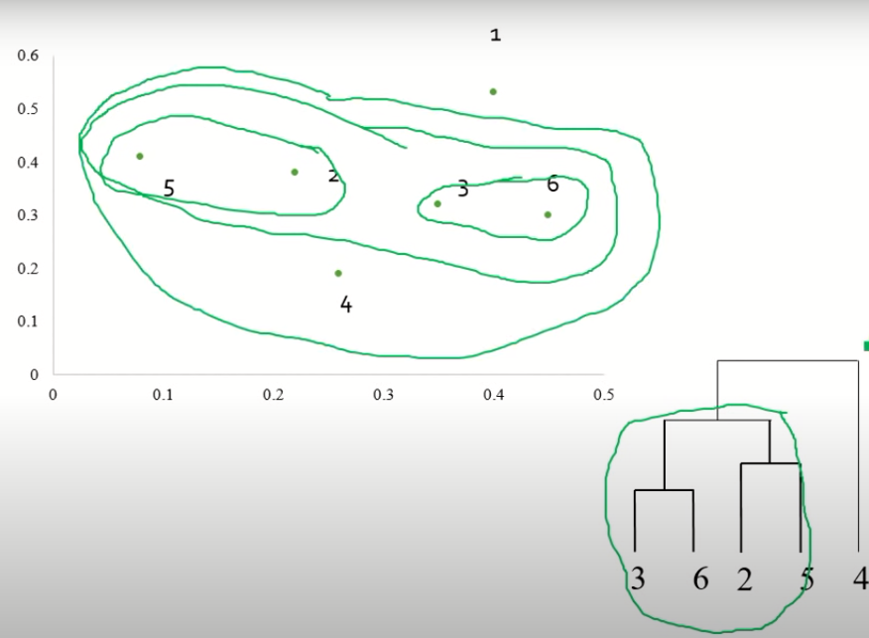
EXAMPLE – SINGLE LINK

Slide 32
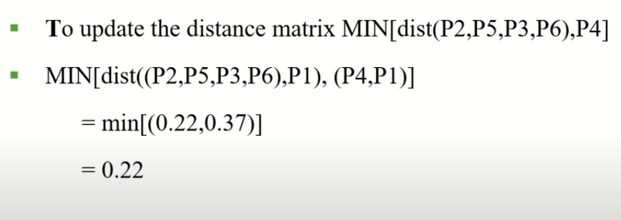
EXAMPLE – SINGLE LINK

Slide 33
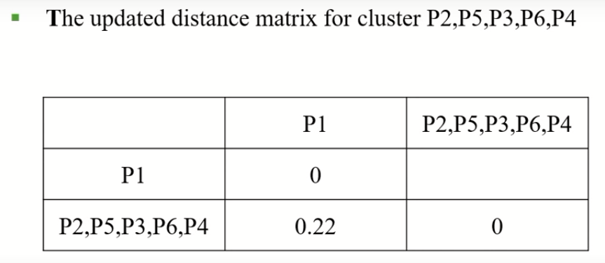
EXAMPLE – SINGLE LINK

Slide 34
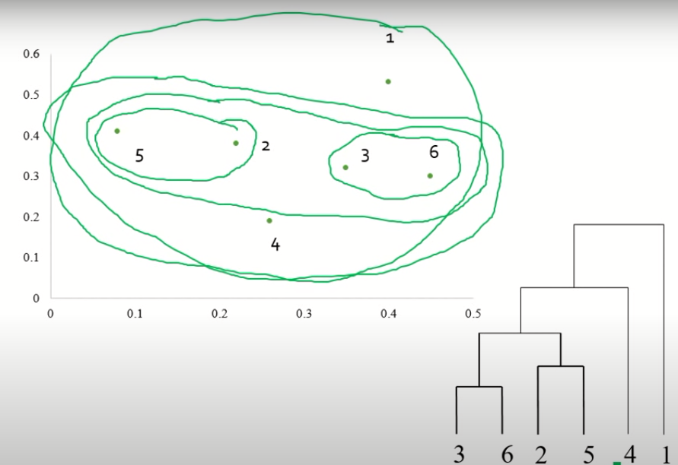
EXAMPLE – SINGLE LINK

Slide 35
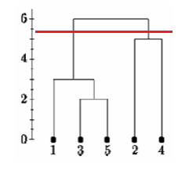
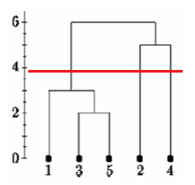
Determining clusters

Slide 36
Inter cluster distance measures
Similarity?
Single Link
Average Link
Complete Link
Distance between centroids

Slide 37
Intermediate situation
We want to merge the two closest clusters (C2 and C5) and update the distance matrix.
C1
C2
C3
C4
C5
C1
C3
C2
C3
C4
C4
C5
C1
Distance Matrix
C2
C5

Slide 38
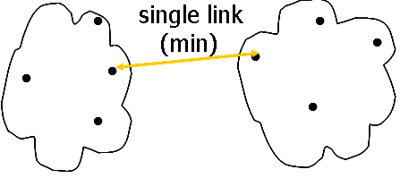
Single link
Smallest distance between an element in one cluster and an element in the other

Slide 39
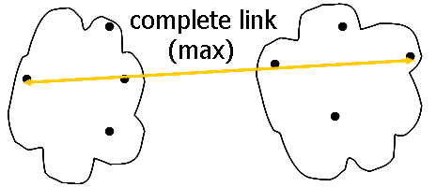
Complete link
Largest distance between an element in one cluster and an element in the other

Slide 40
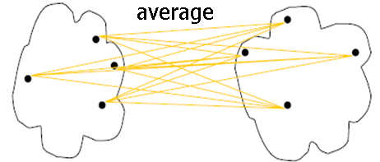
Average Link
Avg distance between an element in one cluster and an element in the other

Slide 41
Distance between centroids
Distance between the centroids of two clusters
×
×

Slide 42
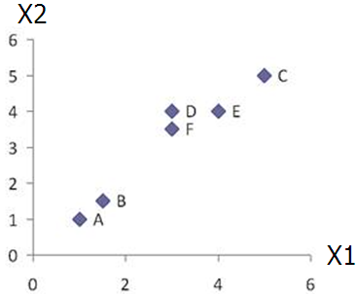
Agglomerative Clustering - Example
 | X1 | X2
A | 1 | 1
B | 1.5 | 1.5
C | 5 | 5
D | 3 | 4
E | 4 | 4
F | 3 | 3.5
Data matrix
Dist | A | B | C | D | E | F
A | 0.00 | 0.71 | 5.66 | 3.61 | 4.24 | 3.20
B | 0.71 | 0.00 | 4.95 | 2.92 | 3.54 | 2.50
C | 5.66 | 4.95 | 0.00 | 2.24 | 1.41 | 2.50
D | 3.61 | 2.92 | 2.24 | 0.00 | 1.00 | 0.50
E | 4.24 | 3.54 | 1.41 | 1.00 | 0.00 | 1.12
F | 3.20 | 2.50 | 2.50 | 0.50 | 1.12 | 0.00
d_{AB} = ((1-1.5)²+(1-1.5)^{2)1/2} = 0.707
Euclidean distance

Slide 43
Agglomerative Clustering - Example
Merge two closest clusters
 | X1 | X2
A | 1 | 1
B | 1.5 | 1.5
C | 5 | 5
D | 3 | 4
E | 4 | 4
F | 3 | 3.5
Merge them into single cluster`
Data matrix
Dist | A | B | C | D | E | F
A | 0.00 | 0.71 | 5.66 | 3.61 | 4.24 | 3.20
B | 0.71 | 0.00 | 4.95 | 2.92 | 3.54 | 2.50
C | 5.66 | 4.95 | 0.00 | 2.24 | 1.41 | 2.50
D | 3.61 | 2.92 | 2.24 | 0.00 | 1.00 | 0.50
E | 4.24 | 3.54 | 1.41 | 1.00 | 0.00 | 1.12
F | 3.20 | 2.50 | 2.50 | 0.50 | 1.12 | 0.00
Find two closest clusters

Slide 44
Agglomerative Clustering - Example
Update Distance Matrix
Dist | A | B | C | D | E | F
A | 0.00 | 0.71 | 5.66 | 3.61 | 4.24 | 3.20
B | 0.71 | 0.00 | 4.95 | 2.92 | 3.54 | 2.50
C | 5.66 | 4.95 | 0.00 | 2.24 | 1.41 | 2.50
D | 3.61 | 2.92 | 2.24 | 0.00 | 1.00 | 0.50
E | 4.24 | 3.54 | 1.41 | 1.00 | 0.00 | 1.12
F | 3.20 | 2.50 | 2.50 | 0.50 | 1.12 | 0.00
Dist | A | B | C | D,F | E
A | 0.00 | 0.71 | 5.66 | ? | 4.24
B | 0.71 | 0.00 | 4.95 | ? | 3.54
C | 5.66 | 4.95 | 0.00 | ? | 1.41
D,F | ? | ? | ? | 0.00 | ?
E | 4.24 | 3.54 | 1.41 | ? | 0.00

Slide 45
Agglomerative Clustering - Example
Update Distance Matrix
Min Distance – Single Linkage
Dist | A | B | C | D | E | F
A | 0.00 | 0.71 | 5.66 | 3.61 | 4.24 | 3.20
B | 0.71 | 0.00 | 4.95 | 2.92 | 3.54 | 2.50
C | 5.66 | 4.95 | 0.00 | 2.24 | 1.41 | 2.50
D | 3.61 | 2.92 | 2.24 | 0.00 | 1.00 | 0.50
E | 4.24 | 3.54 | 1.41 | 1.00 | 0.00 | 1.12
F | 3.20 | 2.50 | 2.50 | 0.50 | 1.12 | 0.00
D_{(D,F)→A} = min(d_{DA},d_{FA})=min(3.61,3.20) = 3.20
D_{(D,F)→B} = min(d_{DB},d_{FB})=min(2.92,2.50) = 2.50
D_{(D,F)→C} = min(d_{DC},d_{FC})=min(2.24,2.50) = 2.24
D_{(D,F)→E} = min(d_{DE},d_{FE})=min(1.00,1.12) = 1.00
Dist | A | B | C | D,F | E
A | 0.00 | 0.71 | 5.66 | ? | 4.24
B | 0.71 | 0.00 | 4.95 | ? | 3.54
C | 5.66 | 4.95 | 0.00 | ? | 1.41
D,F | ? | ? | ? | 0.00 | ?
E | 4.24 | 3.54 | 1.41 | ? | 0.00
Dist | A | B | C | D,F | E
A | 0.00 | 0.71 | 5.66 | 3.20 | 4.24
B | 0.71 | 0.00 | 4.95 | 2.50 | 3.54
C | 5.66 | 4.95 | 0.00 | 2.24 | 1.41
D,F | 3.20 | 2.50 | 2.24 | 0.00 | 1.00
E | 4.24 | 3.54 | 1.41 | 1.00 | 0.00

Slide 46
Agglomerative Clustering - Example
Merge two closest clusters
Dist | A | B | C | D,F | E
A | 0.00 | 0.71 | 5.66 | 3.20 | 4.24
B | 0.71 | 0.00 | 4.95 | 2.50 | 3.54
C | 5.66 | 4.95 | 0.00 | 2.24 | 1.41
D,F | 3.20 | 2.50 | 2.24 | 0.00 | 1.00
E | 4.24 | 3.54 | 1.41 | 1.00 | 0.00
Dist | A,B | C | D,F | E
A,B | 0.00 | ? | ? | ?
C | ? | 0.00 | 2.24 | 1.41
D,F | ? | 2.24 | 0.00 | 1.00
E | ? | 1.41 | 1.00 | 0.00

Slide 47
Agglomerative Clustering - Example
Update Distance Matrix
Dist | A | B | C | D,F | E
A | 0.00 | 0.71 | 5.66 | 3.20 | 4.24
B | 0.71 | 0.00 | 4.95 | 2.50 | 3.54
C | 5.66 | 4.95 | 0.00 | 2.24 | 1.41
D,F | 3.20 | 2.50 | 2.24 | 0.00 | 1.00
E | 4.24 | 3.54 | 1.41 | 1.00 | 0.00
D_{(A,B)→C} = min(d_{CA},d_{CB})=min(5.66,4.95) = 4.95
D_{(A,B)→(D,F)} = min(d_{DA},d_{DB}, d_{FA},d_{FB})
=min(3.61, 2.92, 3.20, 2.50) = 2.50
D_{(A,B)→E} = min(d_{AE},d_{BE})=min(4.24,3.54) = 3.54
Dist | A,B | C | D,F | E
A,B | 0.00 | ? | ? | ?
C | ? | 0.00 | 2.24 | 1.41
D,F | ? | 2.24 | 0.00 | 1.00
E | ? | 1.41 | 1.00 | 0.00
Dist | A,B | C | D,F | E
A,B | 0.00 | 4.95 | 2.50 | 3.54
C | 4.95 | 0.00 | 2.24 | 1.41
D,F | 2.50 | 2.24 | 0.00 | 1.00
E | 3.54 | 1.41 | 1.00 | 0.00

Slide 48
Agglomerative Clustering - Example
Merge two closest clusters/Update Distance Matrix
Dist | A,B | C | D,F | E
A,B | 0.00 | 4.95 | 2.50 | 3.54
C | 4.95 | 0.00 | 2.24 | 1.41
D,F | 2.50 | 2.24 | 0.00 | 1.00
E | 3.54 | 1.41 | 1.00 | 0.00
Dist | (A,B) | C | (D,F),E
(A,B) | 0.00 | 4.95 | 2.50
C | 4.95 | 0.00 | 1.41
(D,F),E | 2.50 | 1.41 | 0.00

Slide 49
Agglomerative Clustering - Example
Merge two closest clusters/Update Distance Matrix
Dist | (A,B) | C | (D,F),E
(A,B) | 0.00 | 4.95 | 2.50
C | 4.95 | 0.00 | 1.41
(D,F),E | 2.50 | 1.41 | 0.00
Dist | (A,B) | ((D,F),E),C
(A,B) | 0.00 | 2.50
((D,F),E),C | 2.50 | 0.00

Slide 50
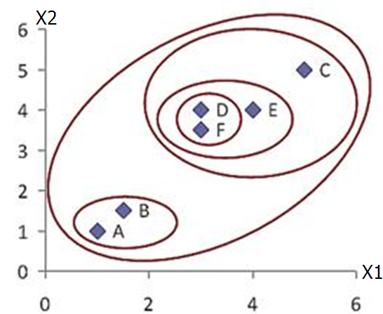
Agglomerative Clustering - Example
Final Result
 | X1 | X2
A | 1 | 1
B | 1.5 | 1.5
C | 5 | 5
D | 3 | 4
E | 4 | 4
F | 3 | 3.5
Data matrix

Slide 51
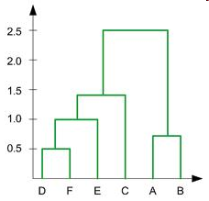
Agglomerative Clustering - Example
Dendrogram Representation
In the beginning we have 6 clusters: A, B, C, D, E and F
We merge cluster D and F into cluster (D, F) at distance 0.50
We merge cluster A and cluster B into (A, B) at distance 0.71
We merge cluster E and (D, F) into ((D, F), E) at distance 1.00
We merge cluster ((D, F), E) and C into (((D, F), E), C) at distance 1.41
We merge cluster (((D, F), E), C) and (A, B) into ((((D, F), E), C), (A, B)) at distance 2.50
The last cluster contain all the objects, thus conclude the computation
6
5
4
3
2

